Slide 1
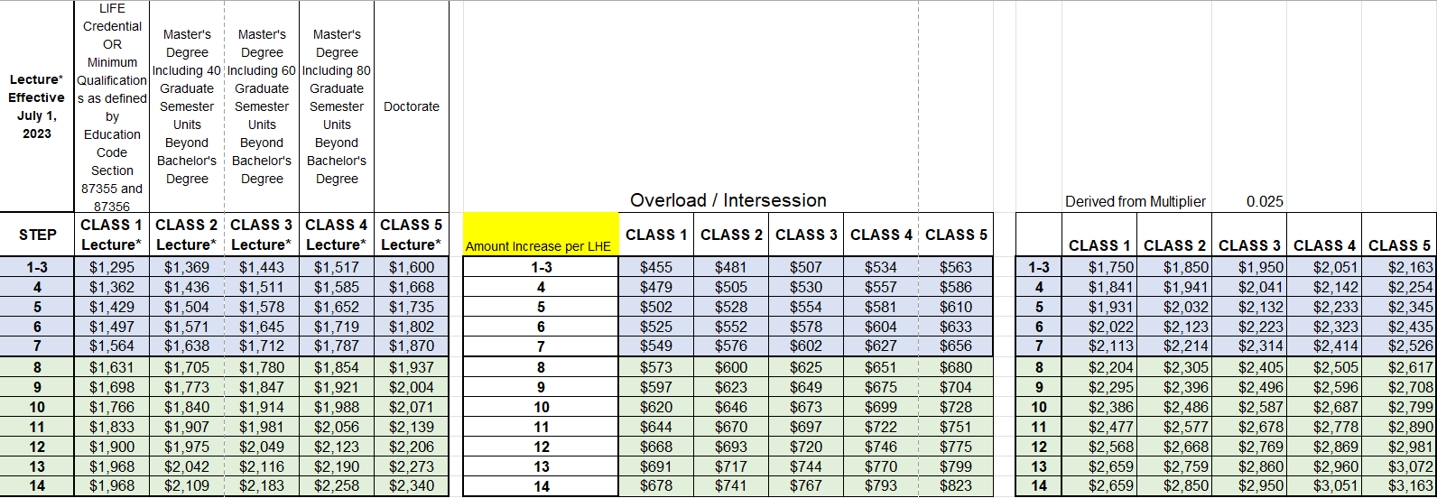
Overload Salary goes to step 7 and Intersession Salary goes to step 14

